Slide 1
Socialization
Understanding Human Development

Slide 2
Sigmund Freud’s Elements of Personality
Freud combined the basic needs and influence of society into a model of personality with three parts:
Id-human’s basic instincts and drive, it is unconscious and demands immediate satisfaction
Ego- A person’s rational approach to satisfy the innate-pleasure seeking drives of the id with the socially acceptable constraints of society.
Superego- Our moral conscious, as developed by our society.

Slide 3
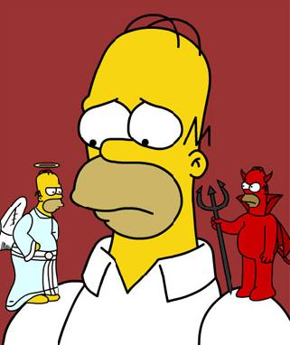
Freud’s Elements of Personality
The ego exists to balance the demands of both the id and the superego.
The ego causes many internal moral dilemmas.
Devil on one shoulder, angel on the other.

Slide 4
Jean Piaget’s Theory of Cognitive Development
Swiss psychologist studied human cognition- how people think and understand
Watching his own children grow up, Piaget identified four stages of development
Sensorimotor Stage (0-2yrs)
Preoperational Stage (3-7yrs)
Concrete Operational Stage (7-11yrs)
Formal Operational Stage (12+ yrs)

Slide 5
Lawrence Kohlberg’s Theory of Moral Development
Focused on how individuals judge situations as right or wrong.
Preconventional Level- experience the world in terms of pain and pleasure, right is pleasure, wrong is pain
Conventional Level- teens, right is what pleases parents and conforms to social norms
Postconventional-begin to move beyond simple social norms to think of the world in terms of liberty, freedom and justice.

Slide 6
Carol Gilligan’s Gender and Moral Development
The two sexes use different standards of rightness.
Boys rely on a justice principle, using formal rules to identify right and wrong.
Girls have a care and responsibility perspective, judging a situation thinking about personal loyalties and relationships.
Stealing is wrong because it breaks the law says males, females are more likely to wonder why and sympathize.

Slide 7
Mead’s Theory of social Self
According to Mead, the self is the part of an individual’s personality that is composed of self awareness and self image.
The self is not there at birth, it develops
Social experience is the exchange of symbols
Social experience develops our understanding of self

Slide 8
Mead’s Looking glass Self
Most famous for explaining how we come to understand ourselves through process called LGS.
We imagine how we must appear to other people
We imagine and react to what we feel their judgment of that appearance must be.
We develop and change ourselves based on our perceived judgment of others

Slide 9
Erikson’s 8 stages of Development
Stage 1: Infancy- trust vs. mistrust
Stage 2: Toddlerhood- autonomy vs. doubt
Stage 3: Preschool- initiative vs. guilt
Stage 4: Preadolescence- industriousness vs. inferior
Stage 5: Adolescence- identity vs. confusion
Stage 6: Young Adulthood- intimacy vs. isolation
Stage 7: Middle Adulthood- making a difference vs. self absorption
Stage 8: Old Age- integrity vs. despair

